Slide 1
Accounting Information and Stock Prices

Slide 2
Agenda
The roles of accounting information
Valuation basics
The relation between earnings, book value, and stock prices
Intro to Compustat
Lab session

Slide 3
The Roles of Accounting Information
  Accounting information plays an important role in a firm and in financial markets
  Accounting information supports important decisions such as investment, lending, performance evaluation, and monitoring

Slide 4
Characteristics of Useful Financial Information
  FASB’s Conceptual Framework views the fundamental qualitative characteristics of useful financial information as:
  Relevance
    “Relevant financial information is capable of making a difference in the decisions made by users”
  Faithful representation
    “To be a perfectly faithful representation… it would be complete, neutral, and free from error”

Slide 5
Valuation Basics
  Financial statement information is used by investors and investment bankers for equity valuation
  A firm (or shares) has value if it can generate cash flows for the owners/investors
  Financial economics defines a firm’s value as the discounted present value of future cash flow (e.g., Williams 1938, Fama and Miller 1972)

Slide 6
“Simple” Present Value
  Question:
  How much will you pay to purchase 1 share that will pay you a one-time cash of $100 in one year (with no risk)?
  $100?
  > $100?
  Or < $100?

Slide 7
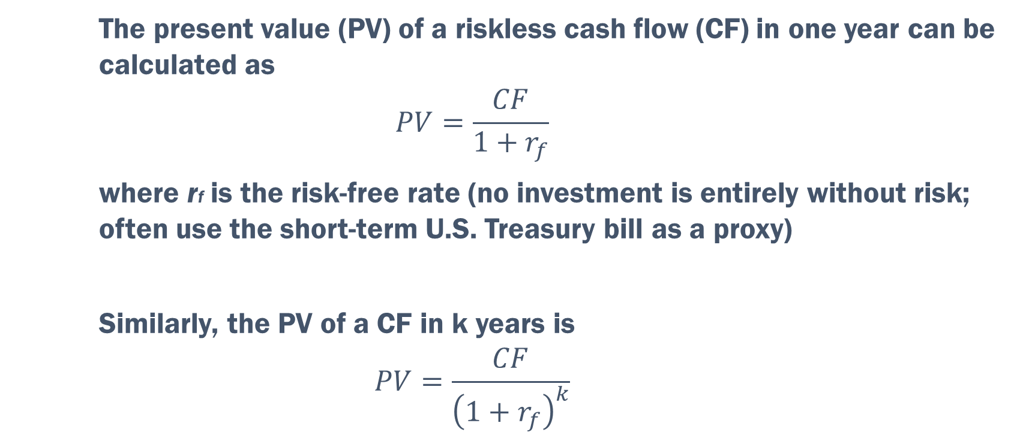
Calculating Present Value
  The present value (PV) of a riskless cash flow (CF) in one year can be calculated as
  $$PV=\frac{CF}{1+r_{f}}$$
  where rf is the risk-free rate (no investment is entirely without risk; often use the short-term U.S. Treasury bill as a proxy)
  Similarly, the PV of a CF in k years is
  $$PV=\frac{CF}{{\left(1+r_{f}\right)}^{k}}$$

Slide 8
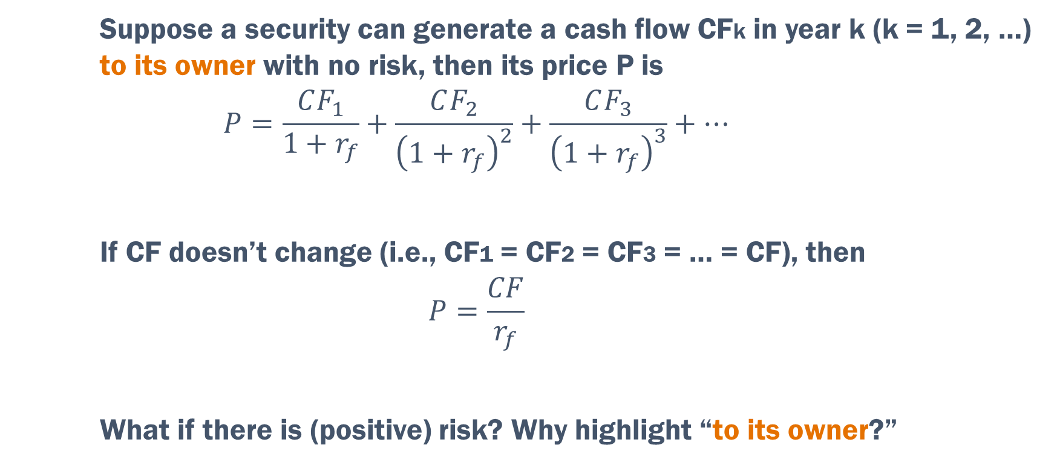
Determining Security Price
  Suppose a security can generate a cash flow CFk in year k (k = 1, 2, …) to its owner with no risk, then its price P is
  $$P=\frac{CF_{1}}{1+r_{f}}+\frac{CF_{2}}{{\left(1+r_{f}\right)}^{2}}+\frac{CF_{3}}{{\left(1+r_{f}\right)}^{3}}+…$$
  If CF doesn’t change (i.e., CF1 = CF2 = CF3 = … = CF), then
  $$P=\frac{CF}{r_{f}}$$
  What if there is (positive) risk? Why highlight “to its owner?”
How to prove?

Slide 9
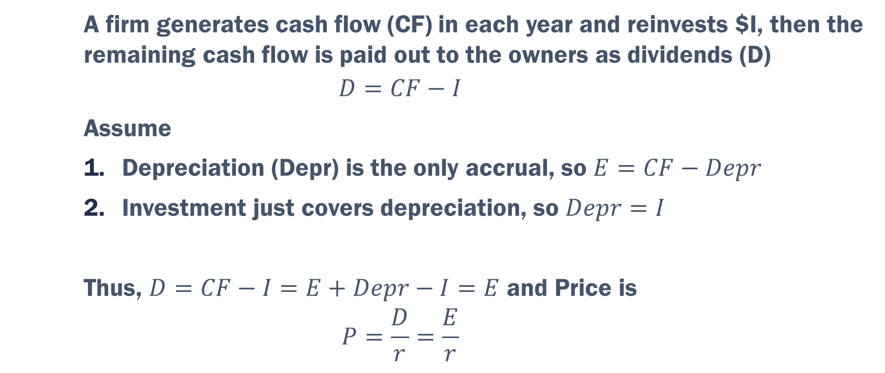
A Simple Model Relating Earnings to Price
  A firm generates cash flow (CF) in each year and reinvests $I, then the remaining cash flow is paid out to the owners as dividends (D)
  $$D=CF−I$$
  Assume
  Depreciation (Depr) is the only accrual, so $E=CF−Depr$
  Investment just covers depreciation, so $Depr=I$
  Thus, $D=CF−I=E+Depr−I=E$ and Price is
  $$P=\frac{D}{r}=\frac{E}{r}$$
Kinda confused by this
The P/E multiple valuation of a stock

Slide 10
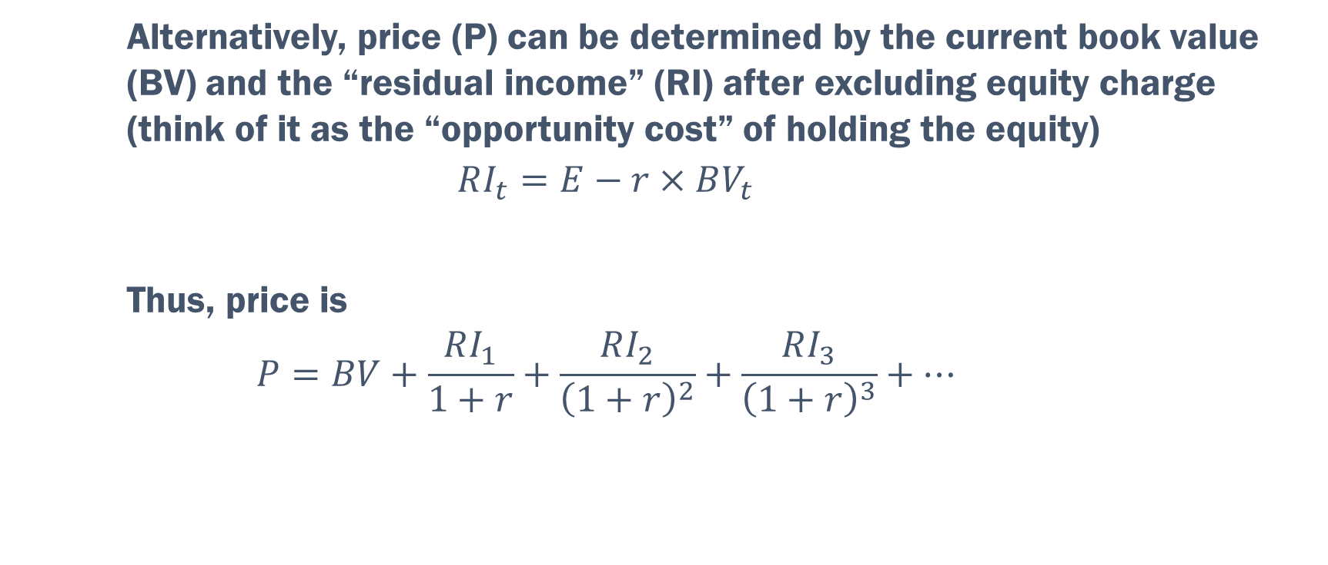
The Residual Income Model (Ohlson 1995)
  Alternatively, price (P) can be determined by the current book value (BV) and the “residual income” (RI) after excluding equity charge (think of it as the “opportunity cost” of holding the equity)
  $$RI_{t}=E−r×BV_{t}$$
  Thus, price is
  $$P=BV+\frac{RI_{1}}{1+r}+\frac{RI_{2}}{{\left(1+r\right)}^{2}}+\frac{RI_{3}}{{\left(1+r\right)}^{3}}+…$$
cost of equity * BVt
Connecting P to both BV and E

Slide 11
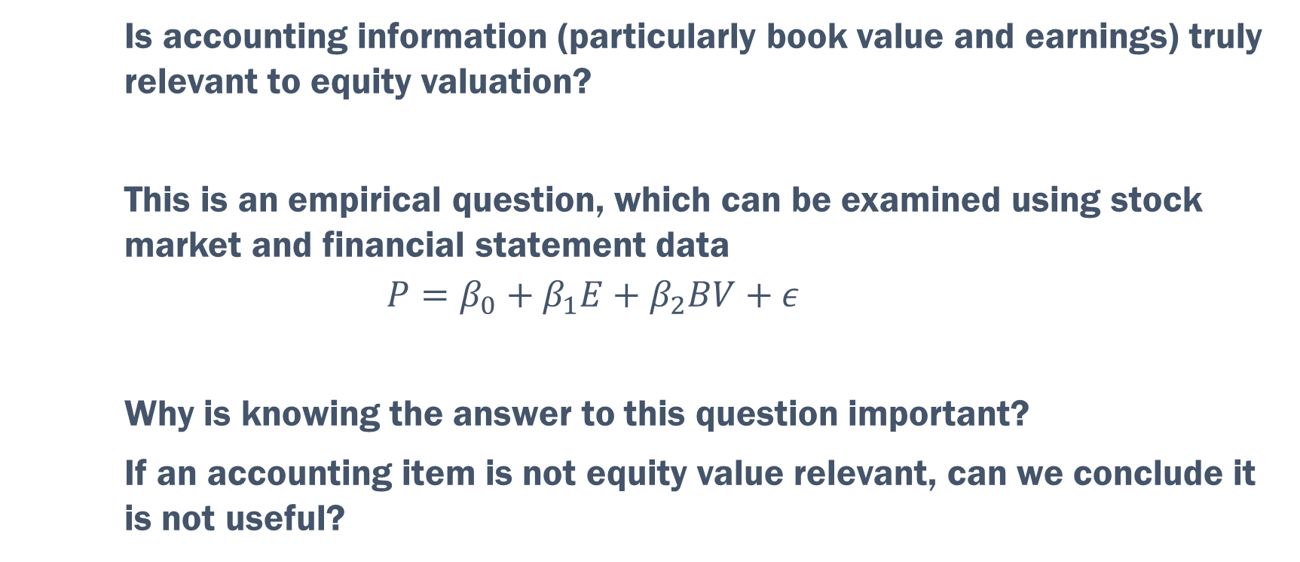
The “Equity Value Relevance” of Accounting Information
  Is accounting information (particularly book value and earnings) truly relevant to equity valuation?
  This is an empirical question, which can be examined using stock market and financial statement data
  $$P=β_{0}+β_{1}E+β_{2}BV+ε$$
  Why is knowing the answer to this question important?
  If an accounting item is not equity value relevant, can we conclude it is not useful?

Slide 12
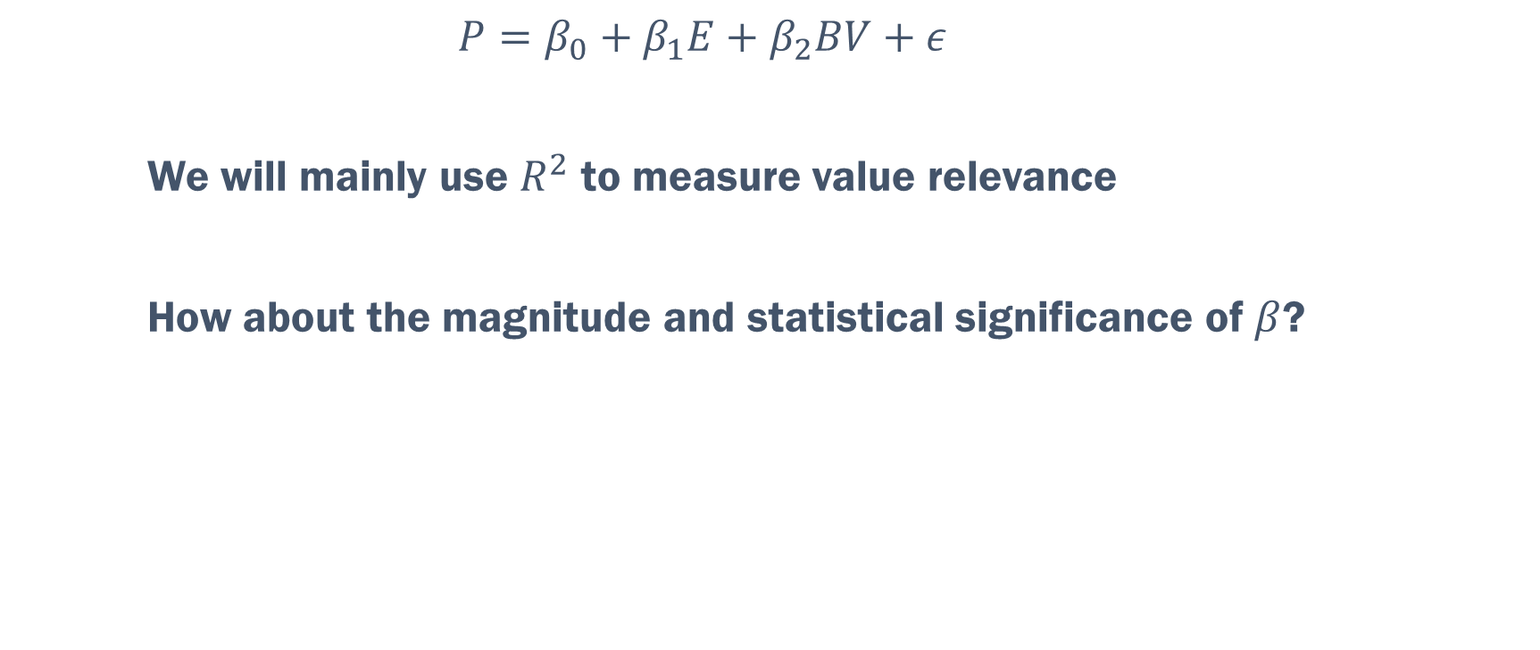
Measuring Value Relevance
  $$P=β_{0}+β_{1}E+β_{2}BV+ε$$
  We will mainly use $R^{2}$ to measure value relevance
  How about the magnitude and statistical significance of $β$?
If equity significant as predictor

Slide 13
Trends in Value Relevance
  People are concerned that accounting information, especially earnings and book values, is becoming less relevant to equity value
  This is especially true for the “new economy” based technology
  We will examine this concern empirically…

Slide 14
Compustat Database
  Compustat is one of the most widely used databases for financial and market information globally
  Developed by Standard & Poor’s Global, Compustat provides more than 500 company-level data from financial statements, including Income Statements and Balance Sheets
  S&P has standardized these data to simplify analysis

Slide 15
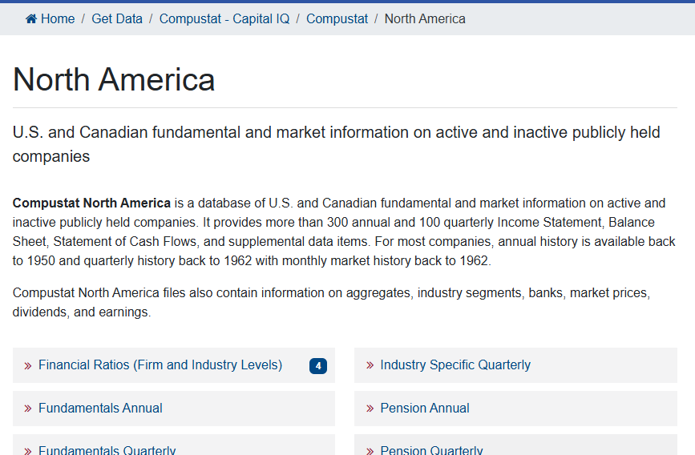
Compustat in WRDS
On the home page, find “Compustat – Capital IQ”
We will use the “North America -> Fundamentals Annual” for annual financial statements data of firms in North America

Slide 16
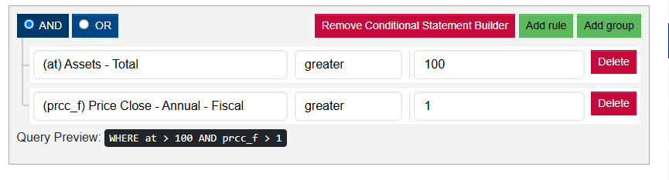
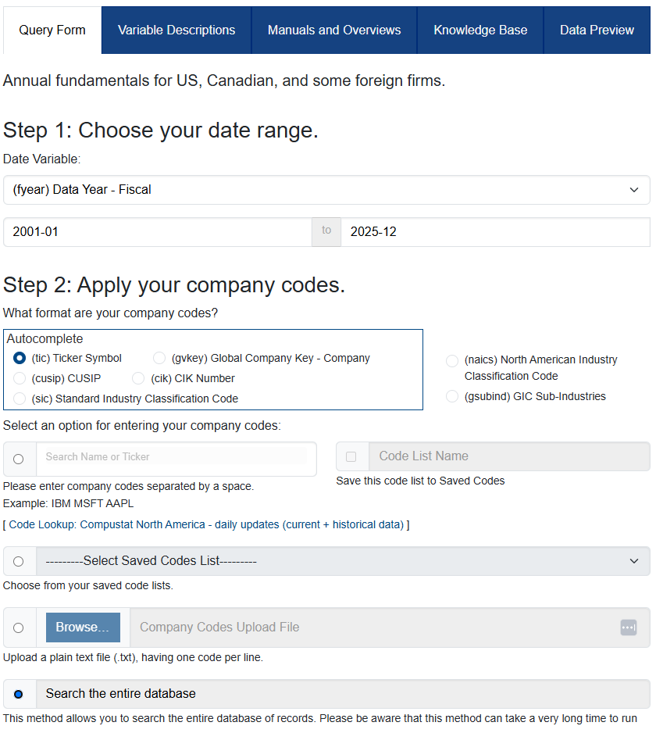
Downloading Compustat Data
Date range: 2001-01 to 2025-12
Search the entire database
Select the following items:
  Fiscal year (fyear)
  Total assets (at)
  income before extraordinary items (ib)
  Common equity (ceq)
  Closing stock price (prcc_f)
  Common shares outstanding (csho)
  SIC industry classification code (sic)
  Exchange code (exchg)
Add rules:
  Total assets > 100 (million)
  Price > 1
Output format: csv

Slide 17
Compustat (cont.) / Assignment 2
See assignment pdf
Much done in class – see actual assignment 2 workbook

